Slide 1
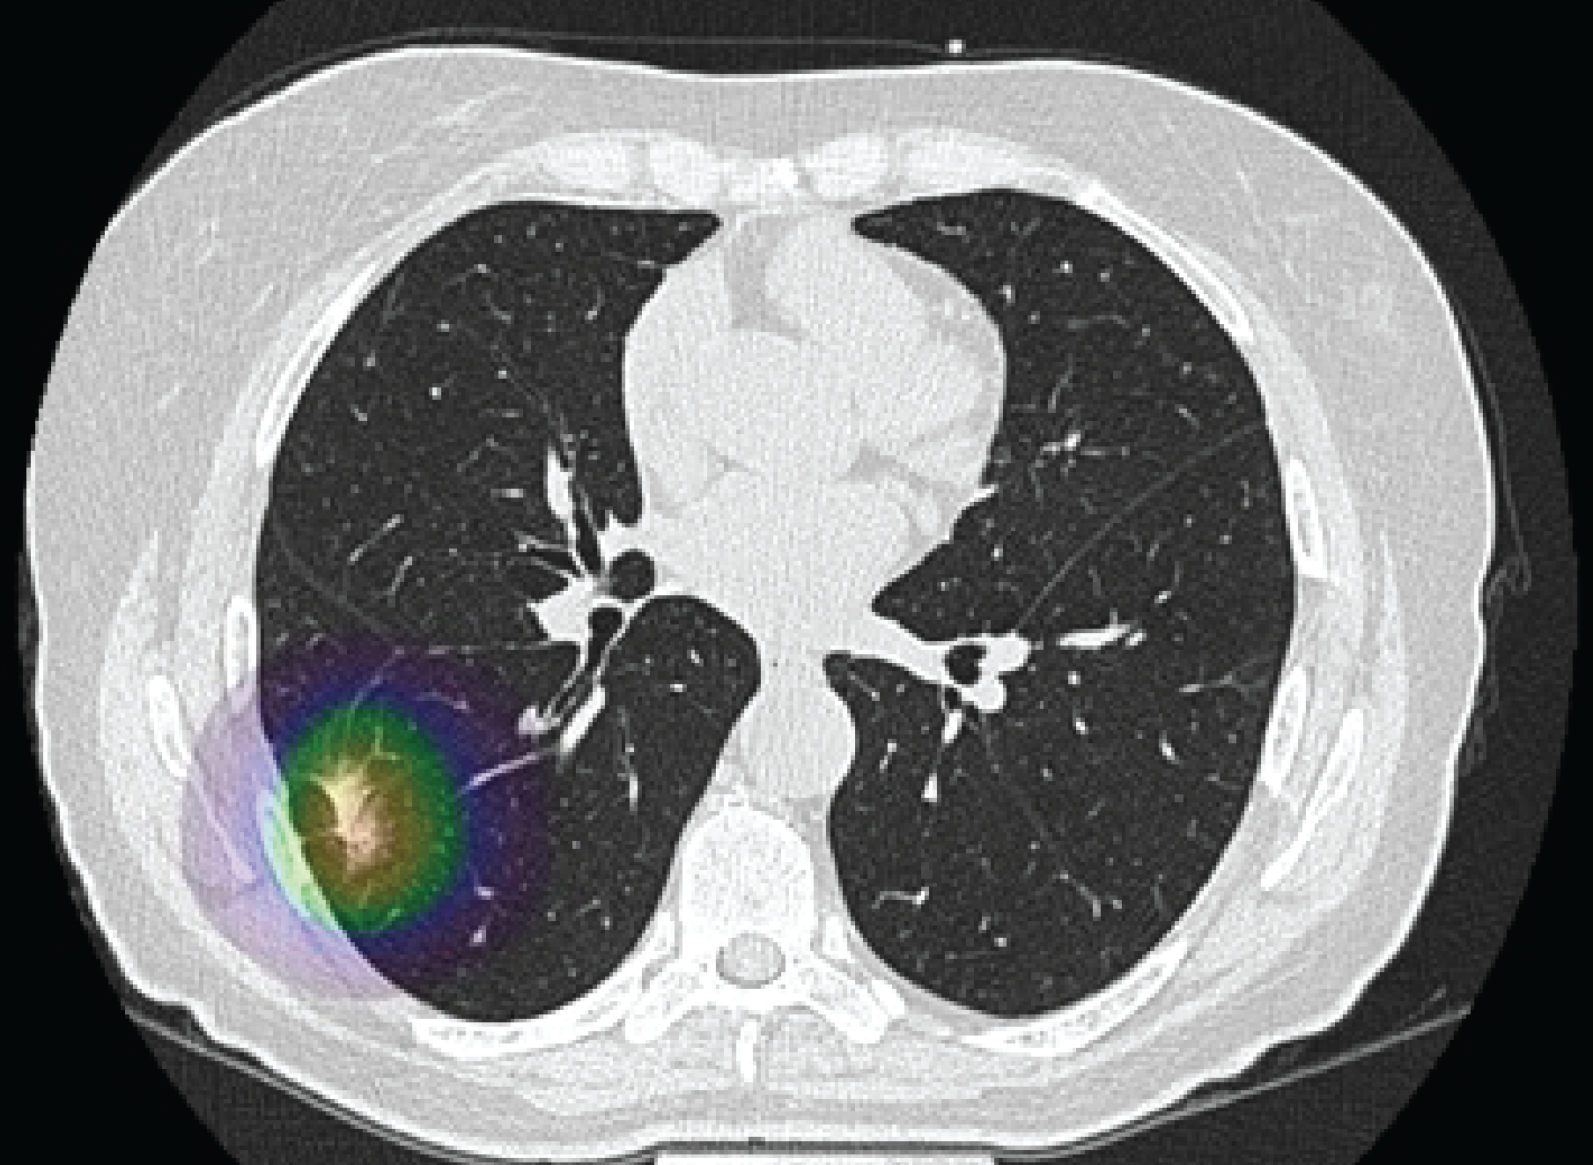
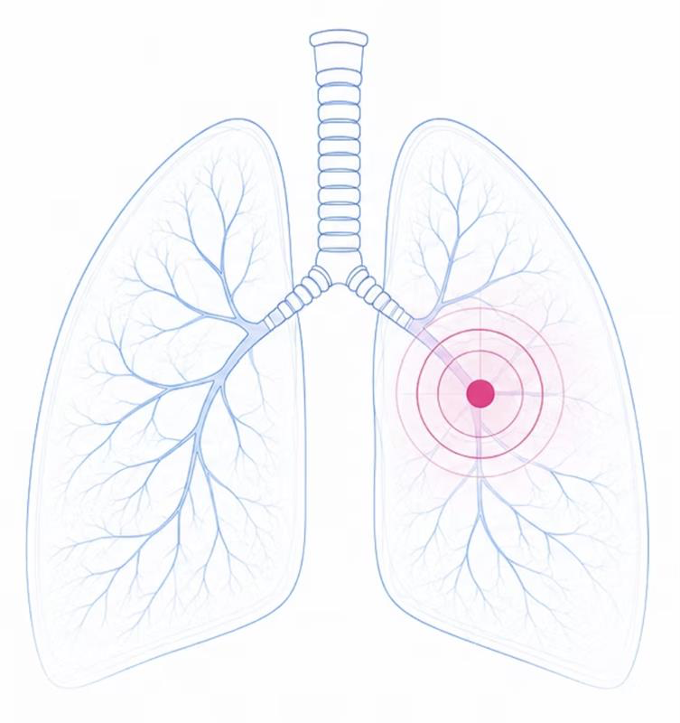
AutoLung AI
A Lung Cancer-Dedicated
Artificial Intelligence Tool
Mohammad Mozafary, MD
On behalf of our team:
Anthony P. Reeves, Ali Hashemi, Kyle Atlas, Chenyu Zhang, Jakob Wasserthal, Thomas Atlas, Alan Ricciuti, Amir Azimi,
Seyed Reza Mirjalili, Amir Ghaffari Jolfayi, Hamed Zarei, Wenjun Fan, Jeffrey I. Mechanick, Andrea D. Branch, Zahi Fayad,
Michael V. McConnell, James R Headrick Jr, Koen Nieman, Paolo Raggi, Jamal S.Rana, David J. Maron, Jagat Narula, Matthew J. Budoff, Roxana Mehran, Kim A. Williams, Predimon K. Shah, Oren Mechanic, Arthur S Agatston, Robert A. Kloner, Nathan D. Wong,
Juan P. de-Torres, J. Alberto Neder, Jessica González, Rowena Yip, Luis M Seijo, Rozemarijn Vliegenthart,
David Yankelevitz, Claudia Henschke, Morteza Naghavi
Notes:
Good afternoon,
I’m Mohammad Mozafary, and will present AutoLung AI, a lung cancer-dedicated artificial intelligence tool

Slide 2
Gap in Lung Cancer Detection
~10% diagnosed via low-dose CT screening Screening pathway gap
65% outside USPSTF criteria Eligibility gap
19% up to date with lung cancer screening Low screening uptake
19M chest CTs + 1M calcium scans annually Non-screening imaging volume
>70% of nodules missed with limited field of view Field-of-view liability concern
Yang HC, Chang A, Visa M, Yoon A, Abbott A, Ma Y, Abazeed ME, Hart EM, Allen BD, Pandolfino JE, Liu YW. Age-based screening for lung cancer surveillance in the US. JAMA Network Open. 2025 Nov 20;8(11):e2546222.
Northam M, Koonce J, Ravenel JG. Pulmonary nodules detected at cardiac CT: comparison of images in limited and full fields of view. American Journal of Roentgenology. 2008 Sep;191(3):878-81.
Foraker R, Sperling L, Bratzke L, Budoff M, Leppert M, Razavi AC, Rodriguez F, Shapiro MD, Whelton S, Wong ND, Yang E. Opportunistic detection of coronary artery calcium on noncardiac chest computed tomography: an emerging tool for cardiovascular disease
American Cancer Society. Latest ACS lung cancer data: only 1 in 5 eligible adults in U.S. screened for lung cancer; 62,000 lives over 5 years could be saved if all eligible screened. Atlanta (GA): American Cancer Society; 2025 Nov 19 [cited 2026 Jul 8]. A
Vachani A, Carroll NM, Simoff MJ, Neslund-Dudas C, Honda S, Greenlee RT, Rendle KA, Burnett-Hartman A, Ritzwoller DP. Stage migration and lung cancer incidence after initiation of low-dose computed tomography screening. Journal of thoracic oncology. 2022
Notes:
1- Before getting into our approach, I want to start with the clinical gap. (CLICK)
2- Only a small minority of lung cancers are currently diagnosed through the low-dose CT screening pathway. (CLICK)
3- Many cancers arise outside current screening eligibility (CLICK),
4- and even among those eligible individuals, screening uptake remains low. (CLICK)
5- At the same time, millions of chest CTs and calcium scans are already being obtained each year (CLICK),
6- However, in cardiac CT, liability concerns around incidental lung findings and follow-up often limits the field-of-view and the opportunity for lung cancer detection.
7- Together, these gaps show the need for systematic AI-supported lung cancer assessment across both screening and non-screening CT.

Slide 3
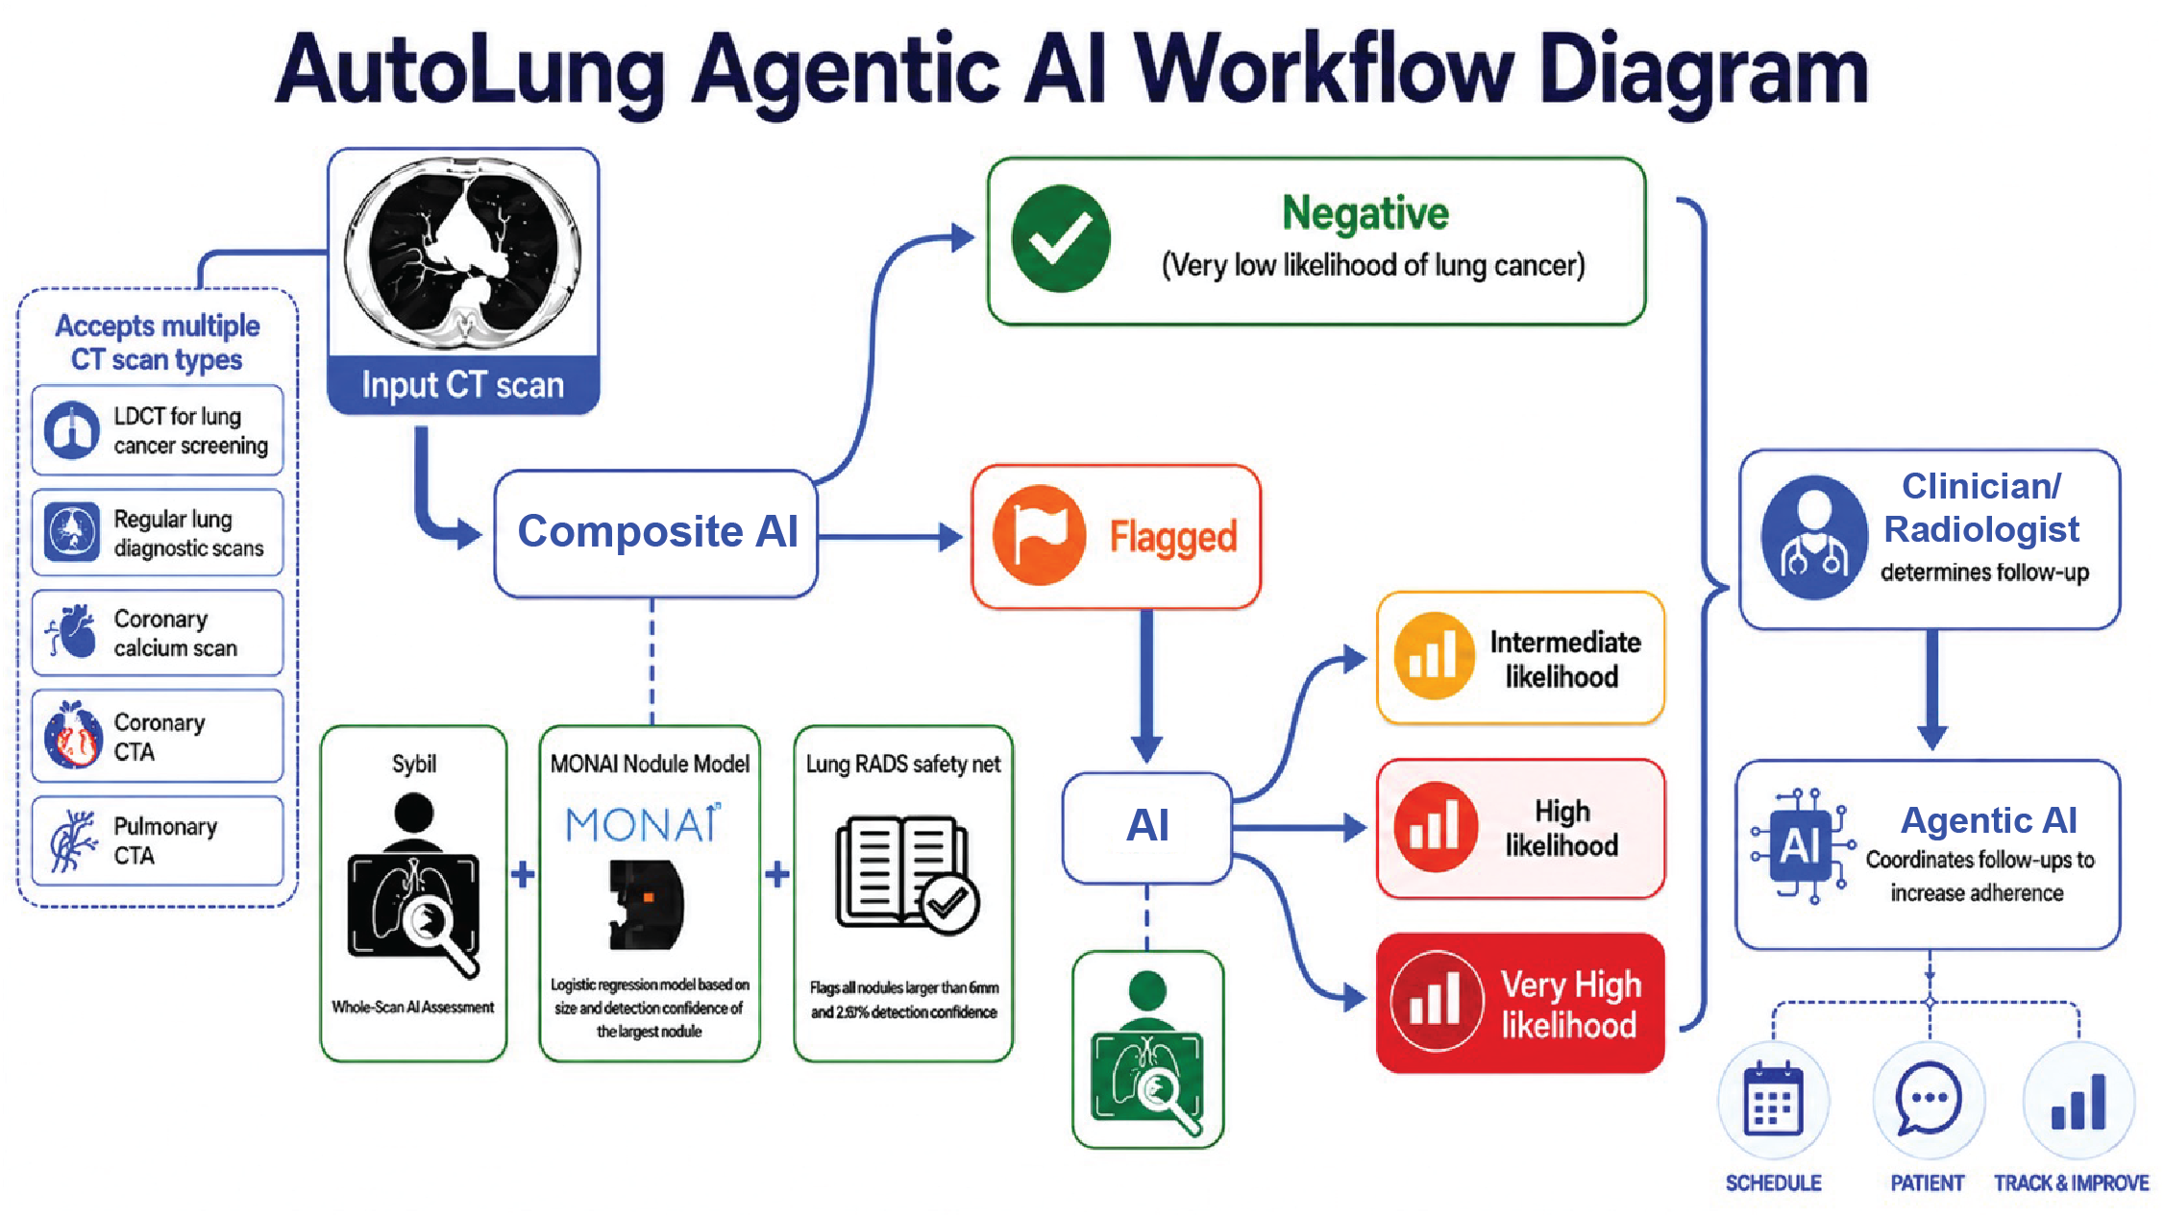
AutoLung AI Architecture
Notes:
AutoLung AI is a composite platform for assessing lung cancer likelihood (CLICK) from multiple CT inputs, including low-dose CT, routine chest CT, calcium scan, and coronary CT angiography

Slide 4
AutoLung AI Architecture
Notes:
It is not just a nodule detector; it integrates whole-scan and nodule-level information into a single assessment

Slide 5
AutoLung AI Architecture
Notes:
and after the clinical plan is determined, agentic AI can help with patient communication and follow-up

Slide 6
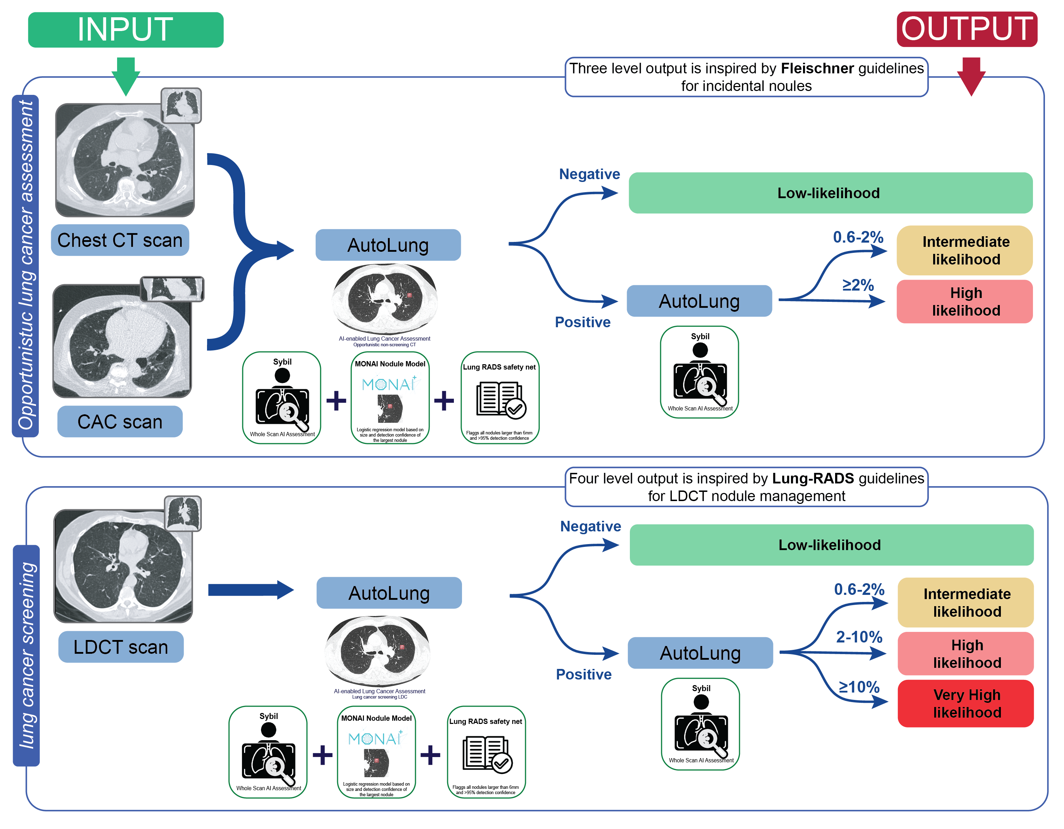
AI Workflow
Opportunistic lung cancer assessment
Lung cancer assessment in low-dose CT scan
Notes:
The workflow is designed for two settings (CLICK).
First, low-dose CT lung cancer screening (CLICK).
Second, opportunistic assessment in non-screening CT, especially calcium scans and routine chest CT.

Slide 7
AI Outperforms Lung-RADS and Captures Missed Cases
Notes:
We compared AI with Lung-RADS

Slide 8
AI Outperforms Lung-RADS and Captures Missed Cases
Notes:
Among more than 6,000 baseline low-dose CT scans, 67 lung cancers were histologically confirmed

Slide 9
AI Outperforms Lung-RADS and Captures Missed Cases
Notes:
AI flagged only 7% of scans as high likelihood, and about 60% as low likelihood

Slide 10
AI Outperforms Lung-RADS and Captures Missed Cases
Notes:
It flagged fewer scans while capturing more cancers, resulting in a higher positive predictive value.

Slide 11
AI Outperforms Lung-RADS and Captures Missed Cases
60% Up classified
Notes:
The heatmap shows that AI up-classified approximately 60% (CLICK) of cancers that fell into low Lung-RADS categories.
Low Lung-RADS cancers:
NLST: 6/10 (60%)
Pamplona: 4/7 (57%)
OVERALL:
NLST: 6/40 (15%)
Pamplona: 4/27 (14.8%)

Slide 12
Beyond Detect:
Predicting Future Lung Cancer
• AI predicts lung cancer over six years
• AI outperforms risk-factor-based prediction model (PLCOm2012)
Notes:
Beyond detection, AI also shows predictive signal

Slide 13
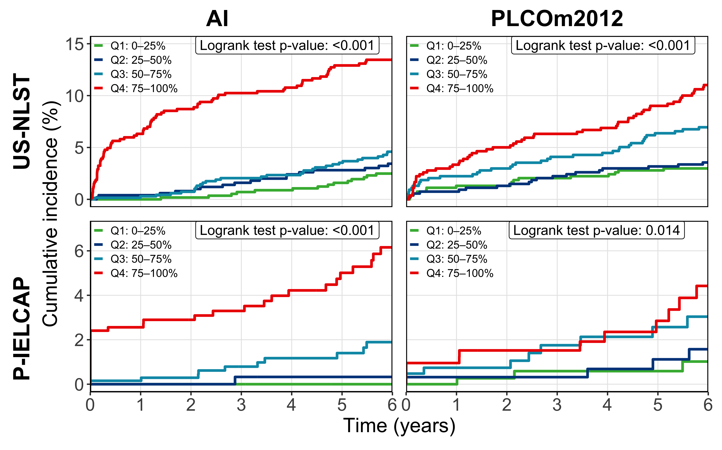
AI versus PLCOm2012
AI outperforms PLCOm2012
At 6-year horizon, whole-lung component of AI shows wider separation and higher cumulative incidence compared to PLCOm2012 (a well-known lung cancer risk model). This supports additive value of AI to PLCOm2012 to guide lung cancer screening.
Notes:
Compared with PLCOm2012, AI showed wider separation for 6-year lung cancer outcomes.

Slide 14
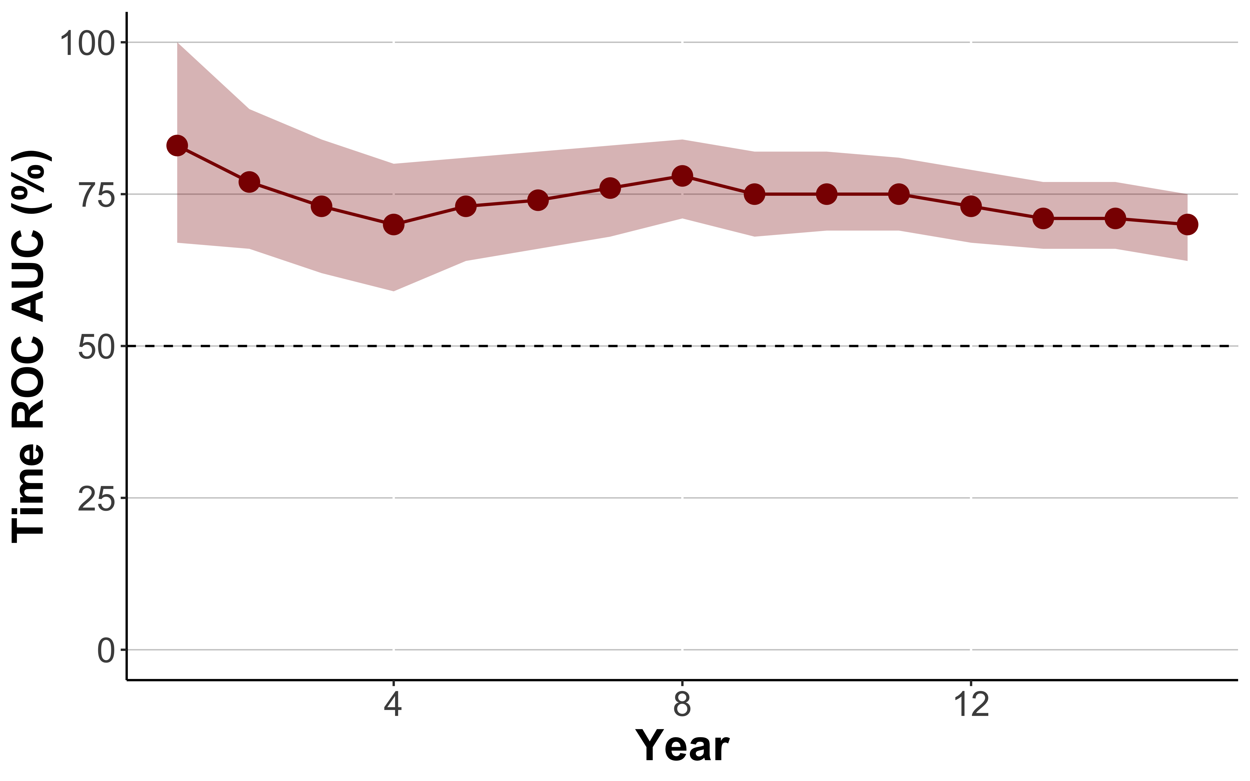
Mixed Detection and Prediction Signal
AI goes beyond detection
AI shows ~70% AUC for lung cancer diagnosis over 15 years. This supports a mixed signal for detection and prediction.
Notes:
The ROC AUC gradually declined over time but remained fairly stable at around 70% even out to 15 years,

Slide 15
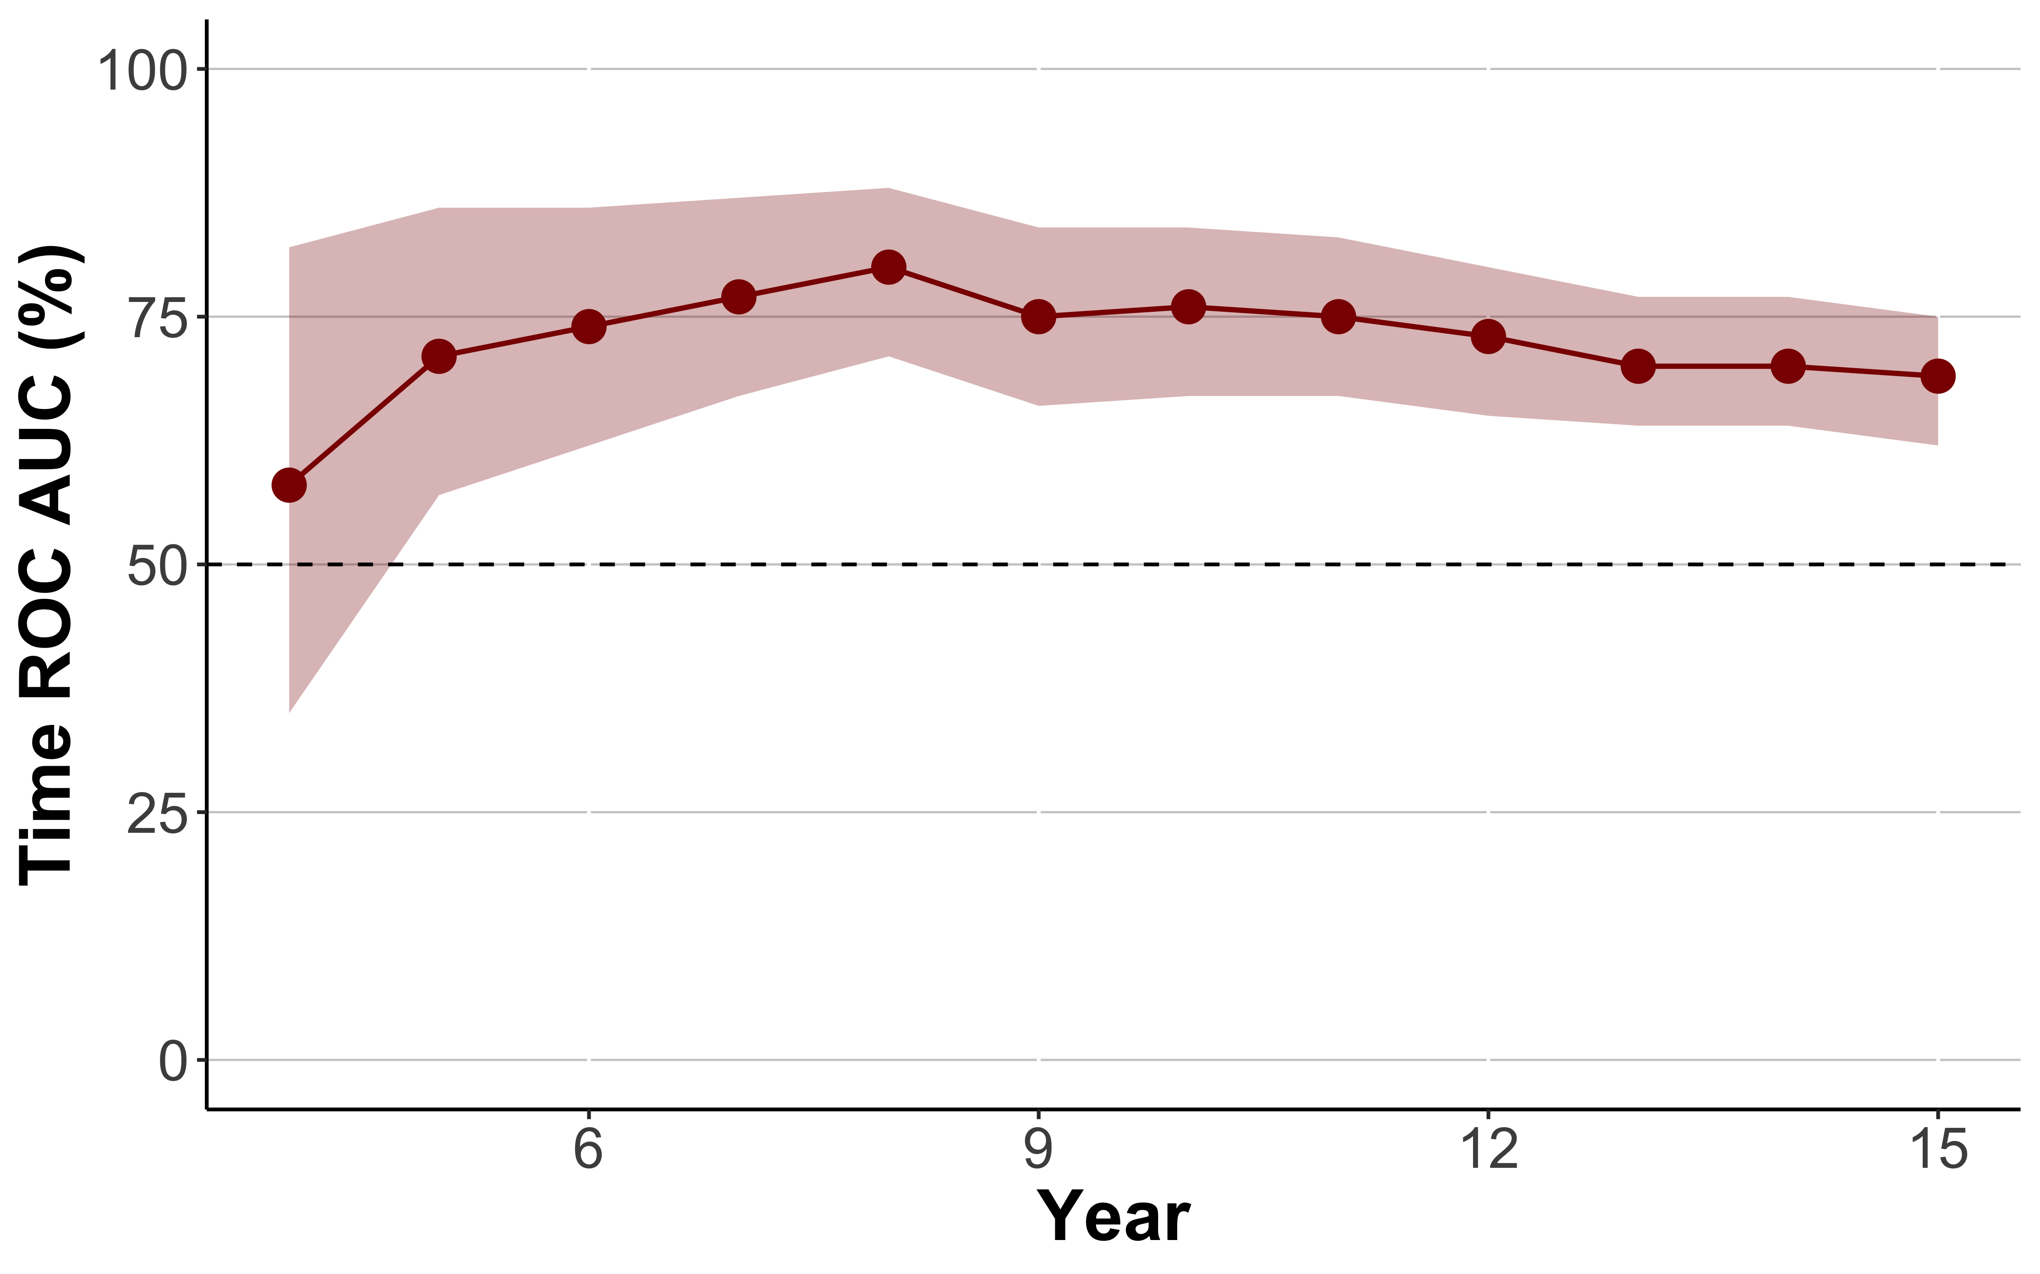
Predictive Signal
We observed prediction signal after excluding detection period
By excluding lung cancers diagnosed in the first three years (detection period), we isolated predictive signals.
Notes:
And after excluding cancers diagnosed in the first 3 years, the signal persisted,
Together, these findings suggest that AI captures both a detection signal and a broader predictive signal.

Slide 16
Opportunistic Lung Cancer Assessment
AI detects lung cancer in CAC scans and non-screening chest CT as well
Notes:
This becomes especially important in opportunistic CT.

Slide 17
How Large Is the Opportunity In Non-Screening CT?
Non-screening CT scans
43.7 million
Eligible for CAC scan
Millions of thoracic CT scans
More than 12 million thoracic CT scans
Approximately 18.7% (2.4 million) eligible people are up to date with LDCT screening
At the same time, CAC scanning is rapidly growing as it has become incorporated into cardiovascular prevention guidelines
12.8 million
Eligible for lung cancer screening
Anderson TS, Wilson LM, Sussman JB. Atherosclerotic cardiovascular disease risk estimates using the predicting risk of cardiovascular disease events equations. JAMA internal medicine. 2024 Aug;184(8):963-70.
https://pressroom.cancer.org/2025-lung-cancer-data?utm_source=chatgpt.com
Notes:
Calcium scan already reaches far more patients than formal low-dose CT screening,
and lung cancer screening uptake remains low

Slide 18
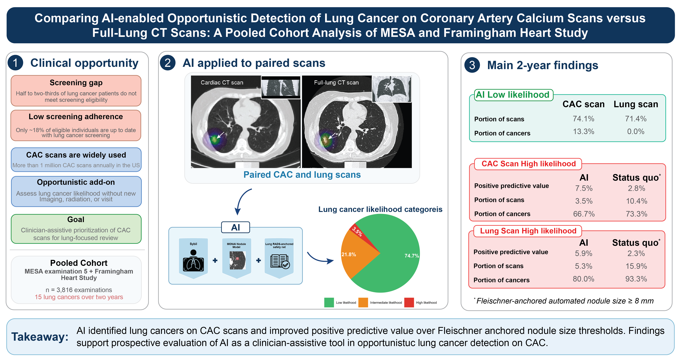
AI is Validated in CAC Scan and Non-Screening Chest CT Scan with Higher PPV than Nodule Size
Notes:
AI can use these scans to identify patients with elevated lung cancer likelihood,

Slide 19
AI is Validated in CAC Scan and Non-Screening Chest CT Scan with Higher PPV than Nodule Size
Notes:
In paired calcium scan and chest CT scans from the same individuals,

Slide 20
AI is Validated in CAC Scan and Non-Screening Chest CT Scan with Higher PPV than Nodule Size
Notes:
Performance was meaningful on both calcium scans [CLICK] and routine chest CT [CLICK].
And AI outperformed nodule size in both.

Slide 21
Never-Smoker, Who are Left Out of Screening
AI predicts lung cancer in never smokers as well as ever smokers
Notes:
Finally, AI is relevant in never-smokers who are left out of screening, as well as ever-smokers.

Slide 22
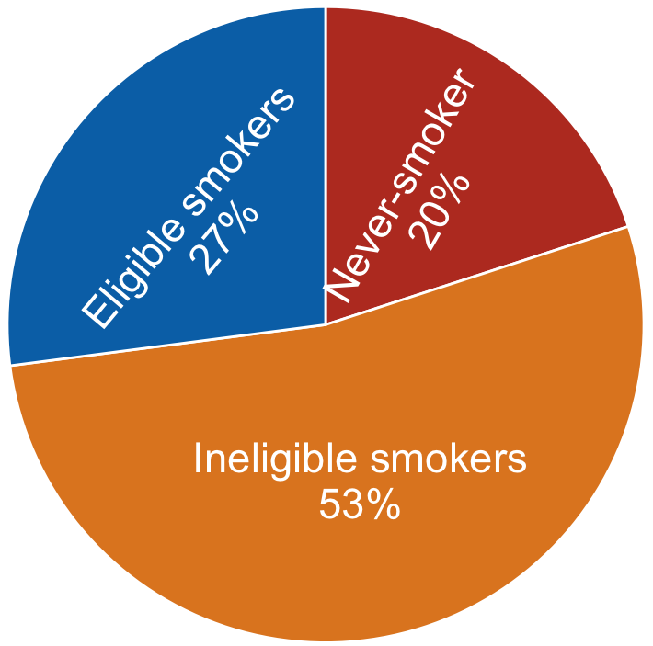
Current Screening Eligibility Misses Many Future Lung Cancers
Lung cancers within 15 years
Screening-ineligible
20% Never-smokers
53% Ineligible smokers
Screening-eligible
27% eligible smokers
Notes:
Only 27% of cancers occurred in screening-eligible smokers;
and most were outside eligibility, including never-smokers. This is the eligibility gap.

Slide 23
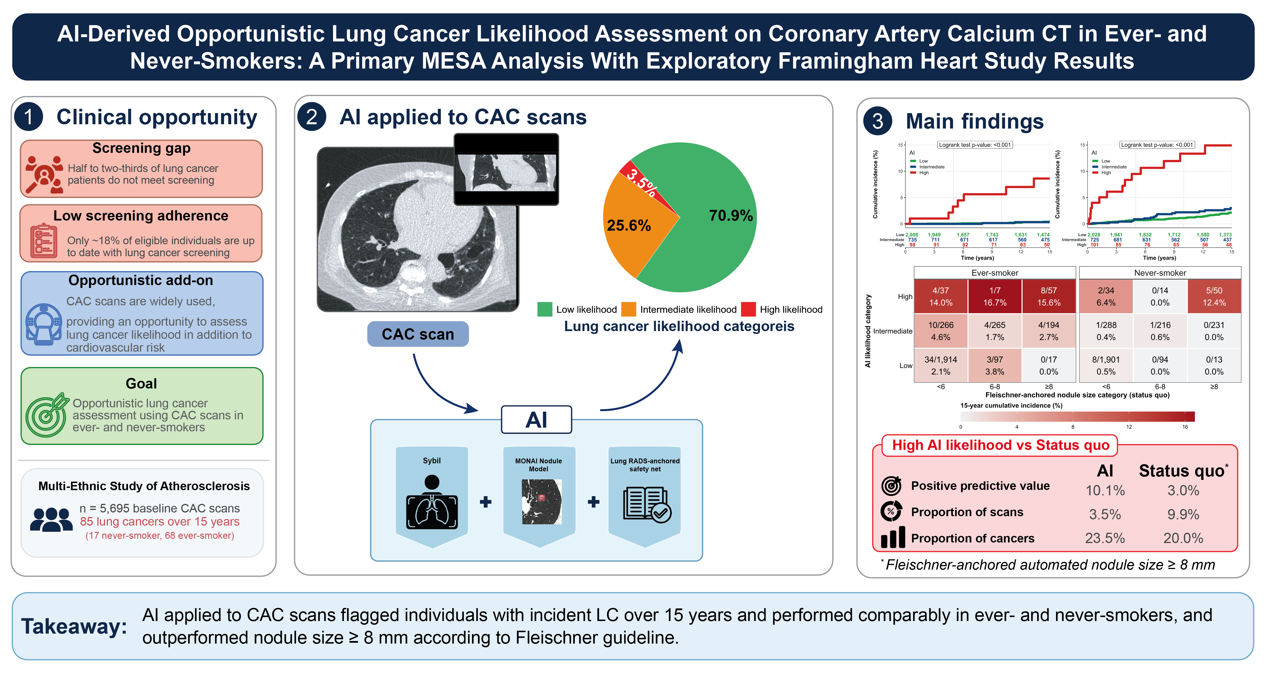
AI is Validated on Never-Smoker, Who are Left Out of Screening, With Better Performance than Nodule Size
Notes:
This matters because never-smokers are outside current screening eligibility, yet they still develop lung cancer.

Slide 24
AI is Validated on Never-Smoker, Who are Left Out of Screening, With Better Performance than Nodule Size
Notes:
AI showed meaningful separation in both groups,

Slide 25
AI is Validated on Never-Smoker, Who are Left Out of Screening, With Better Performance than Nodule Size
Notes:
again outperforming a nodule-size-only approach based on positive predictive value

Slide 26
Take-Home Massage
AI can turn all thoracic CT, especially calcium scans, into an opportunity for early detection and treatment of lung cancer, as well as predicting and preventing future late-stage cancer
It works on never-smokers and former-smokers who are ineligible for screening
Notes:
So in summary, (CLICK)

Slide 27
Thank you for your attention

