Slide 1
AI-CVD
AI-Enabled Cardiovascular Disease Risk Assessment Engine Based on Coronary Artery Calcium (CAC) and Chest CT Scans
Dr. Seyed Reza Mirjalili, MD
Kyle Atlas, Anthony P. Reeves, Chenyu Zhang, Jakob Wasserthal, Amir Azimi, Ali Hashemi, Mohammadhossein Mozafarybazargany, Amir Ghaffari Jolfayi, Alan Ricciuti, Thomas Atlas, Claudia I. Henschke, David F. Yankelevitz, Javier J. Zulueta, Wenjun Fan, Jeffrey I.Mechanick, Andrea D.Branch, Khurram Nasir, Zahi Fayad, Michael V. McConnell, Jamal S.Rana, Rozemarijn Vliegenthart, David J. Maron, Jagat Narula, Matthew J. Budoff, Roxana Mehran, Kim A. Williams, Predimon K. Shah, Oren Mechanic, Arthur S Agatston, Robert A.Kloner, Nathan D. Wong , Morteza Naghavi
Notes:
Good afternoon, everyone at SCCT. My name is Reza Mirjalili from HeartLung, and I am delighted to present AI-CVD: an AI-Enabled Cardiovascular Disease Risk Assessment Engine Based on Coronary Artery Calcium (CAC) and Chest CT Scans
.

Slide 2
What is AI-CVD?
Notes:
The first question you may have is: what exactly is AI-CVD?

Slide 3
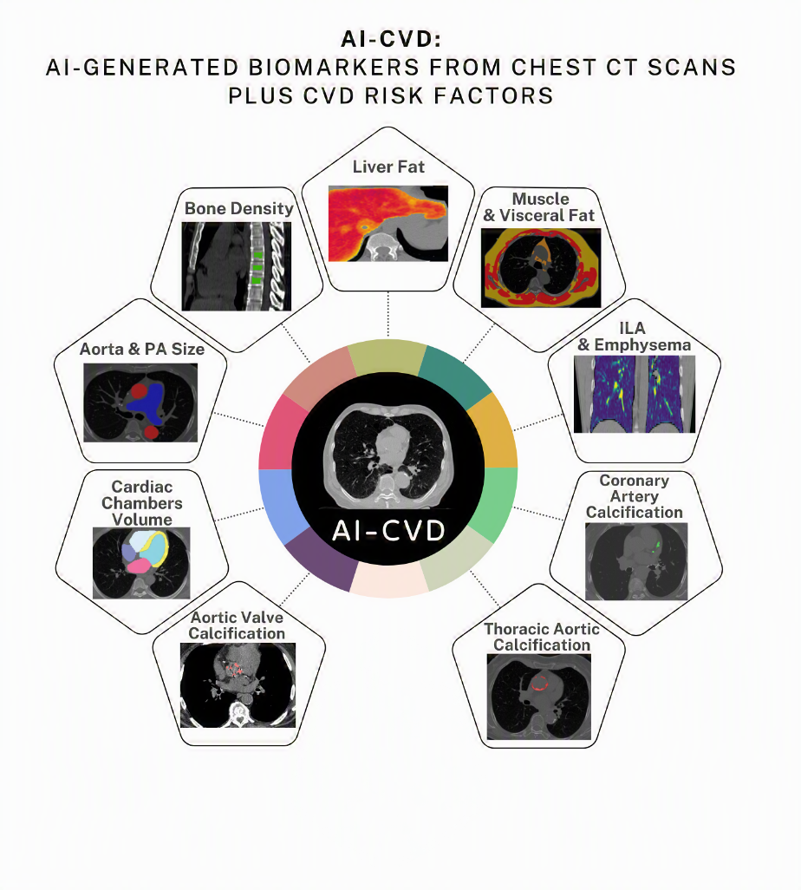
AI-CVD Imaging Biomarkers
Notes:
AI-CVD is a platform designed to extract multiple cardiometabolic and systemic biomarkers from coronary artery calcium scans and other chest CT scans to improve cardiovascular disease prediction and prevention. These biomarkers include coronary artery calcification, extracoronary calcifications such as valvular and aortic calcification, cardiac chamber volumes and ratios, great vessel measurements, epicardial and visceral adiposity, liver fat, muscle volume and myosteatosis, bone mineral density, as well as lung abnormalities such as emphysema and fibrotic changes.

Slide 4
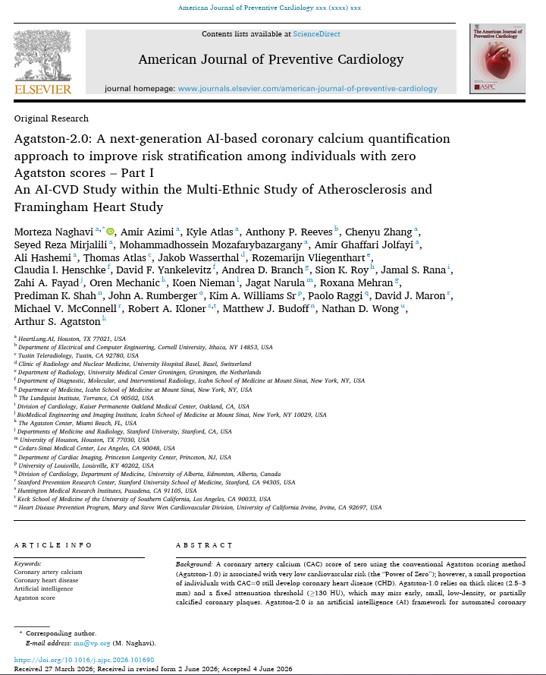
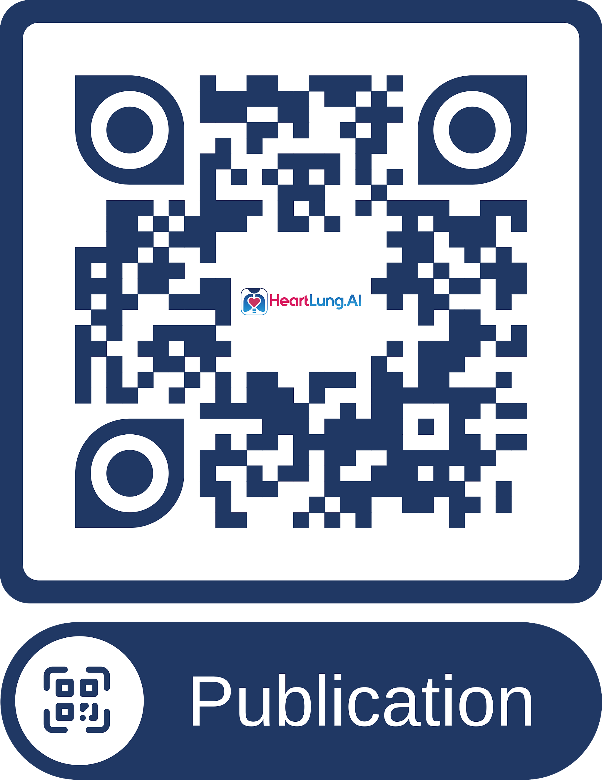
AI-CVD Imaging Biomarkers
Naghavi, M., et al. (2026). "Agatston-2.0: A Next-Generation AI-Based Coronary Calcium Quantification Approach to Improve Risk Stratification Among Individuals with Zero Agatston Scores – Part I." American Journal of Preventive Cardiology: 101698
Notes:
AI-CVD is a platform designed to extract multiple cardiometabolic and systemic biomarkers from coronary artery calcium scans to improve cardiovascular disease prediction and prevention. These biomarkers include coronary artery calcification, extracoronary calcifications such as valvular and aortic calcification, cardiac chamber volumes and ratios, great vessel measurements, epicardial and visceral adiposity, liver fat, muscle volume and myosteatosis, bone mineral density as well as lung abnormalities such as emphysema and fibrotic changes.

Slide 5
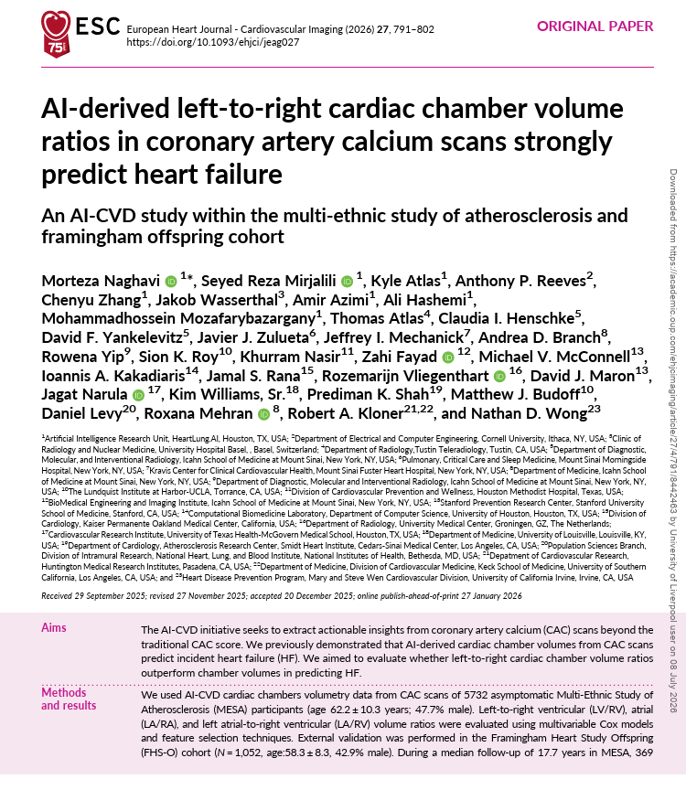
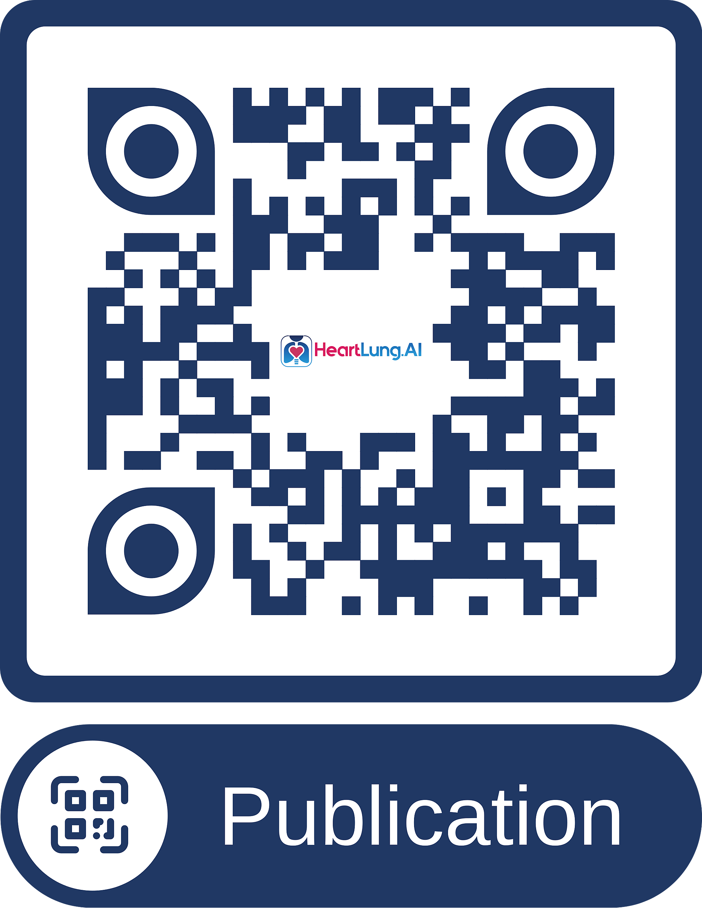
AI-CVD Imaging Biomarkers
Naghavi, M., et al. (2026). "AI-derived left-to-right cardiac chamber volume ratios in coronary artery calcium scans strongly predict heart failure." European Heart Journal - Cardiovascular Imaging 27(4): 791-802.
Notes:
AI-CVD is a platform designed to extract multiple cardiometabolic and systemic biomarkers from coronary artery calcium scans to improve cardiovascular disease prediction and prevention. These biomarkers include coronary artery calcification, extracoronary calcifications such as valvular and aortic calcification, cardiac chamber volumes and ratios, great vessel measurements, epicardial and visceral adiposity, liver fat, muscle volume and myosteatosis, bone mineral density as well as lung abnormalities such as emphysema and fibrotic changes.

Slide 6
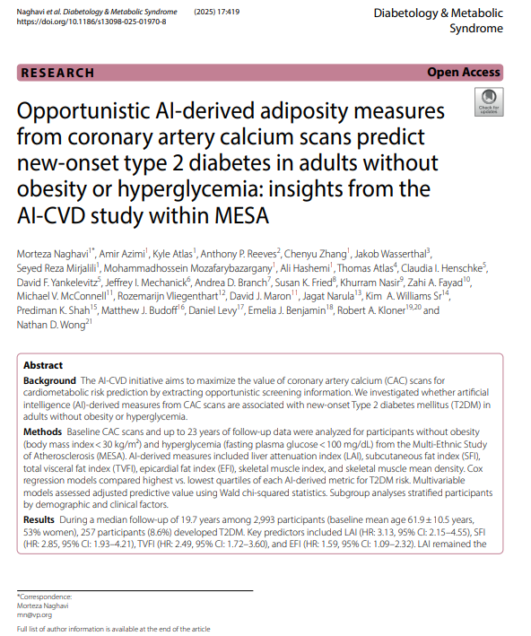
AI-CVD Imaging Biomarkers
Naghavi, M., et al. (2025). "Opportunistic AI-derived adiposity measures from coronary artery calcium scans predict new-onset type 2 diabetes in adults without obesity or hyperglycemia: insights from the AI-CVD study within MESA." Diabetology & Metabolic Syndrome 17(1): 419.
Notes:
AI-CVD is a platform designed to extract multiple cardiometabolic and systemic biomarkers from coronary artery calcium scans to improve cardiovascular disease prediction and prevention. These biomarkers include coronary artery calcification, extracoronary calcifications such as valvular and aortic calcification, cardiac chamber volumes and ratios, great vessel measurements, epicardial and visceral adiposity, liver fat, muscle volume and myosteatosis, bone mineral density as well as lung abnormalities such as emphysema and fibrotic changes.

Slide 7
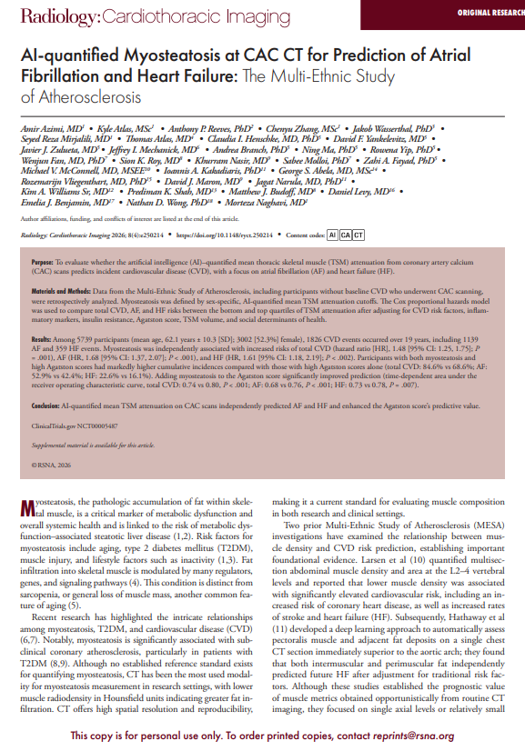
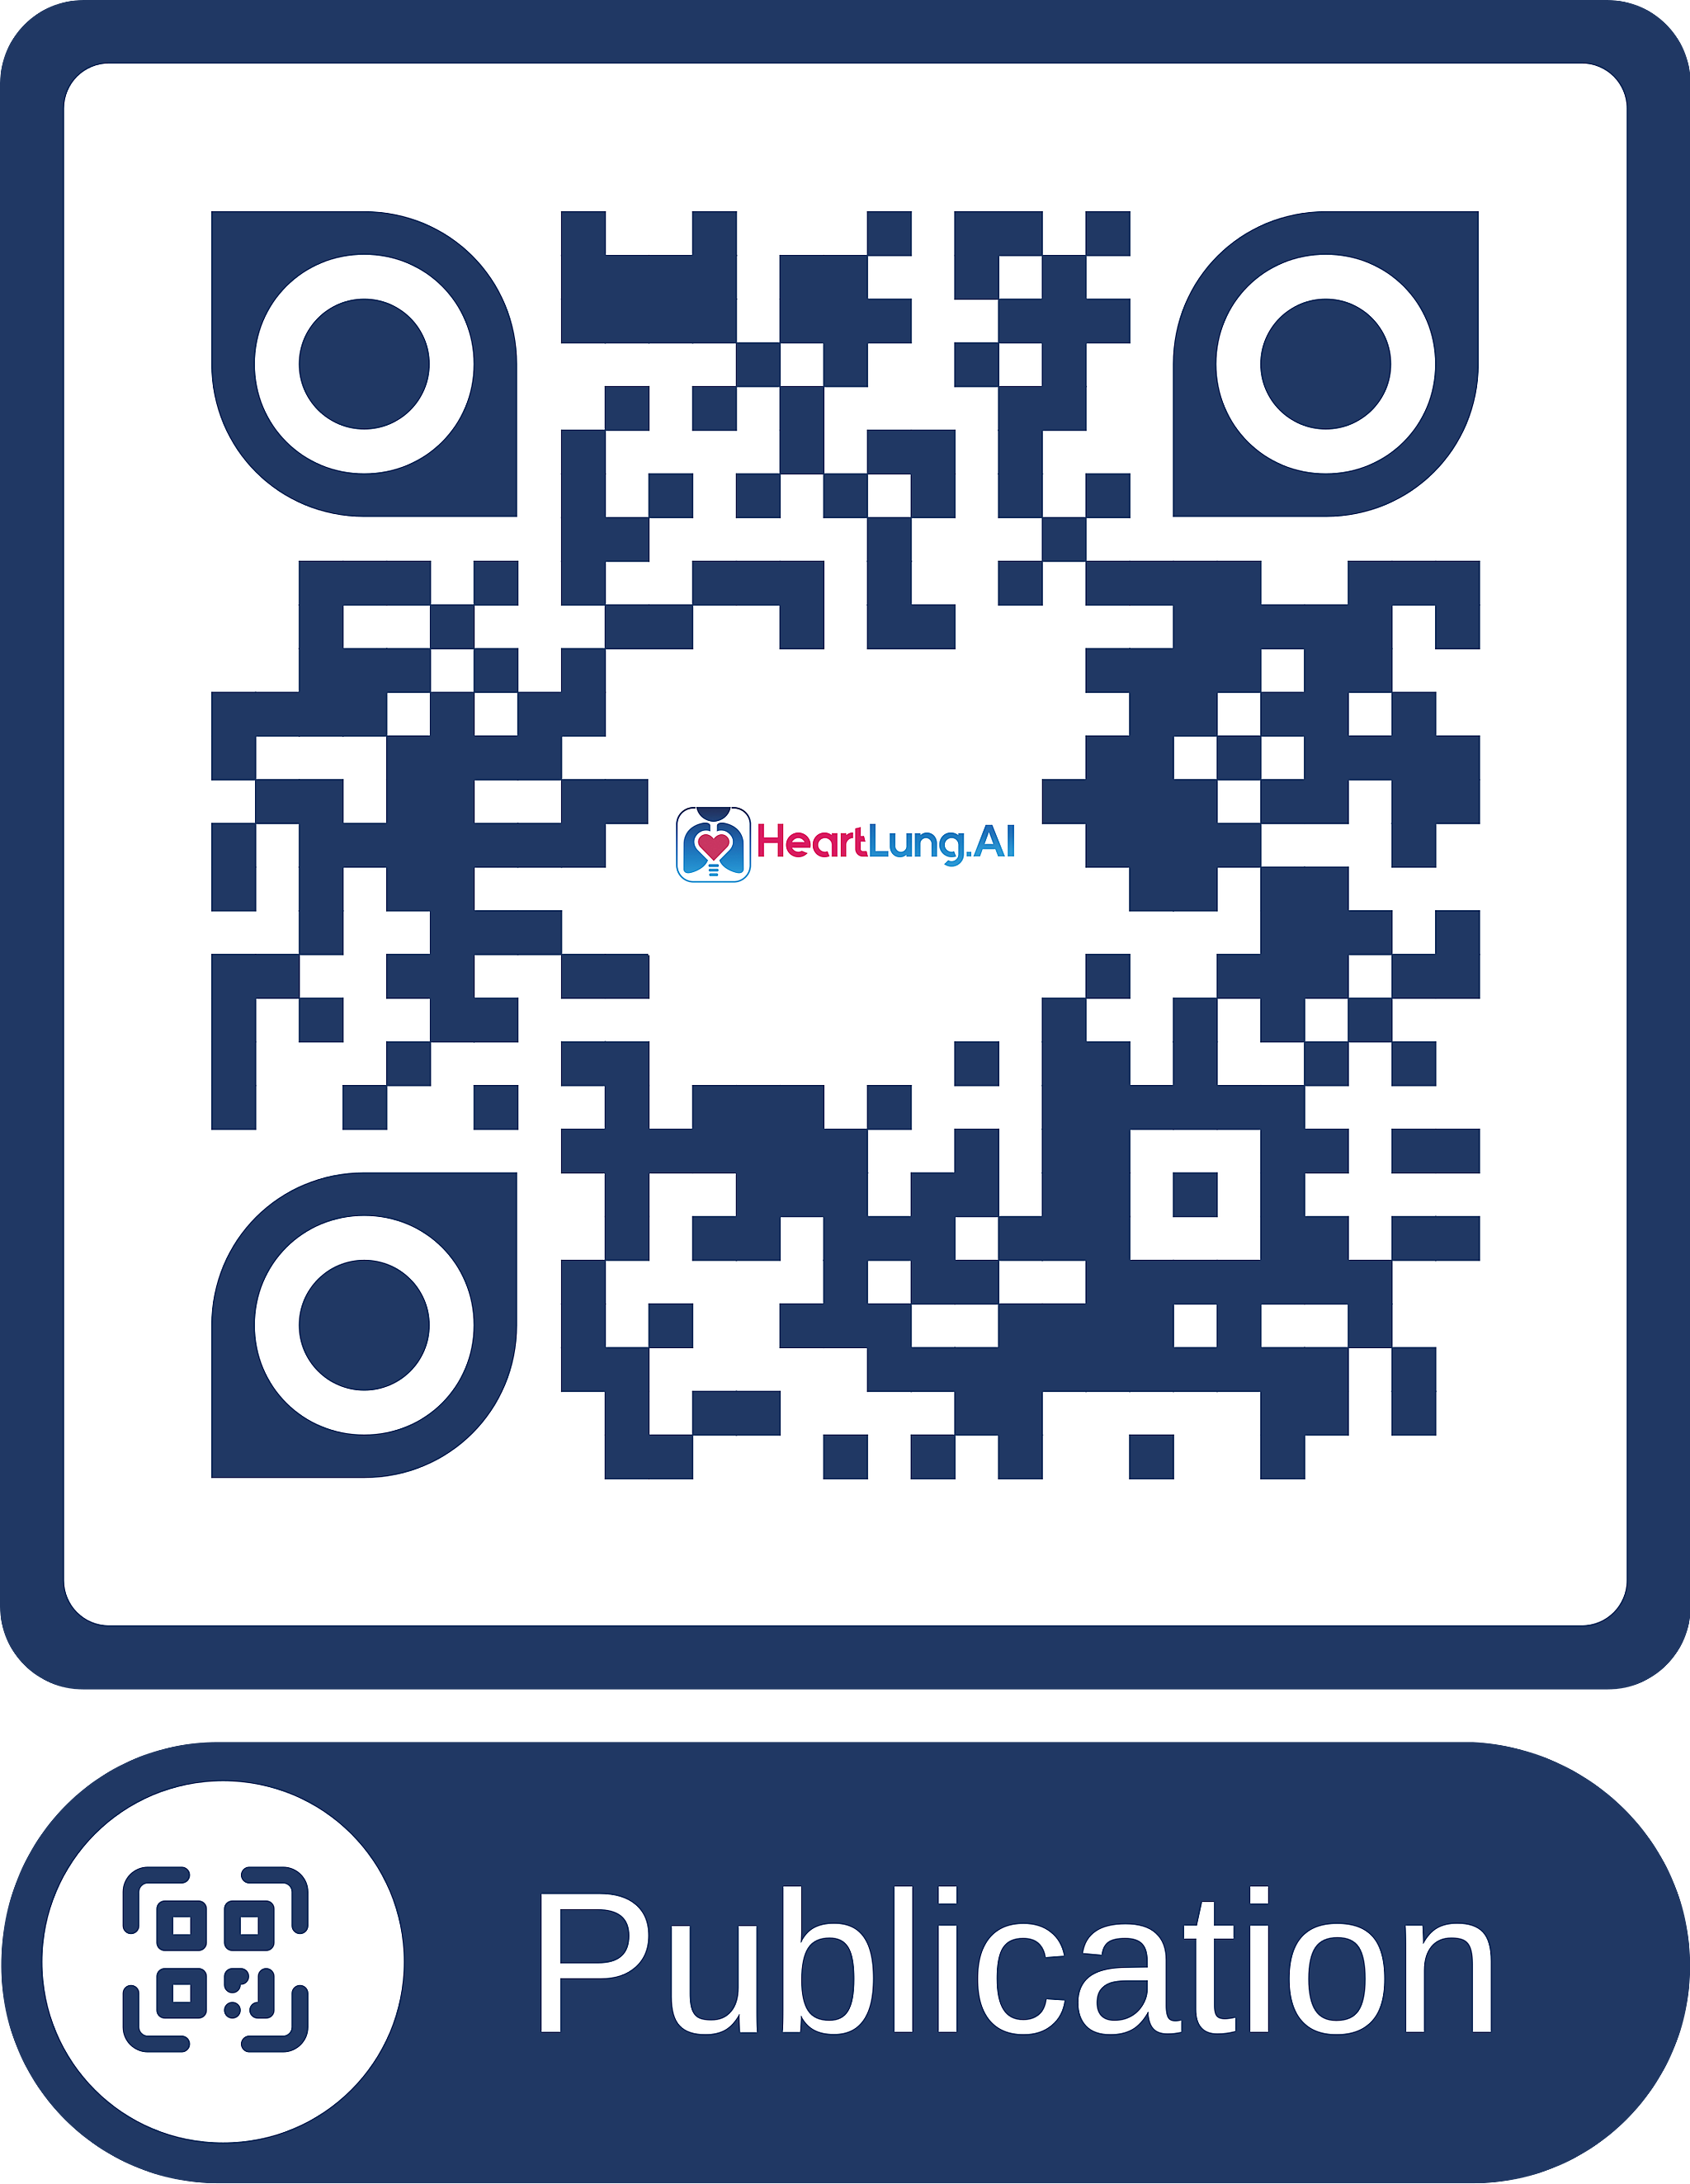
AI-CVD Imaging Biomarkers
Azimi, A., et al. (2026). "AI-quantified Myosteatosis at CAC CT for Prediction of Atrial Fibrillation and Heart Failure: The Multi-Ethnic Study of Atherosclerosis." Radiology: Cardiothoracic Imaging 8(4): e250214.
Notes:
AI-CVD is a platform designed to extract multiple cardiometabolic and systemic biomarkers from coronary artery calcium scans to improve cardiovascular disease prediction and prevention. These biomarkers include coronary artery calcification, extracoronary calcifications such as valvular and aortic calcification, cardiac chamber volumes and ratios, great vessel measurements, epicardial and visceral adiposity, liver fat, muscle volume and myosteatosis, bone mineral density as well as lung abnormalities such as emphysema and fibrotic changes.

Slide 8
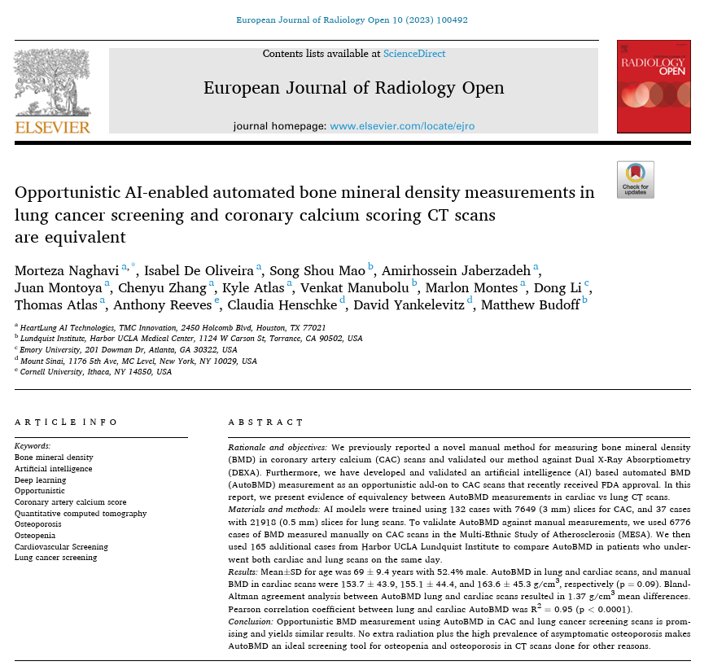
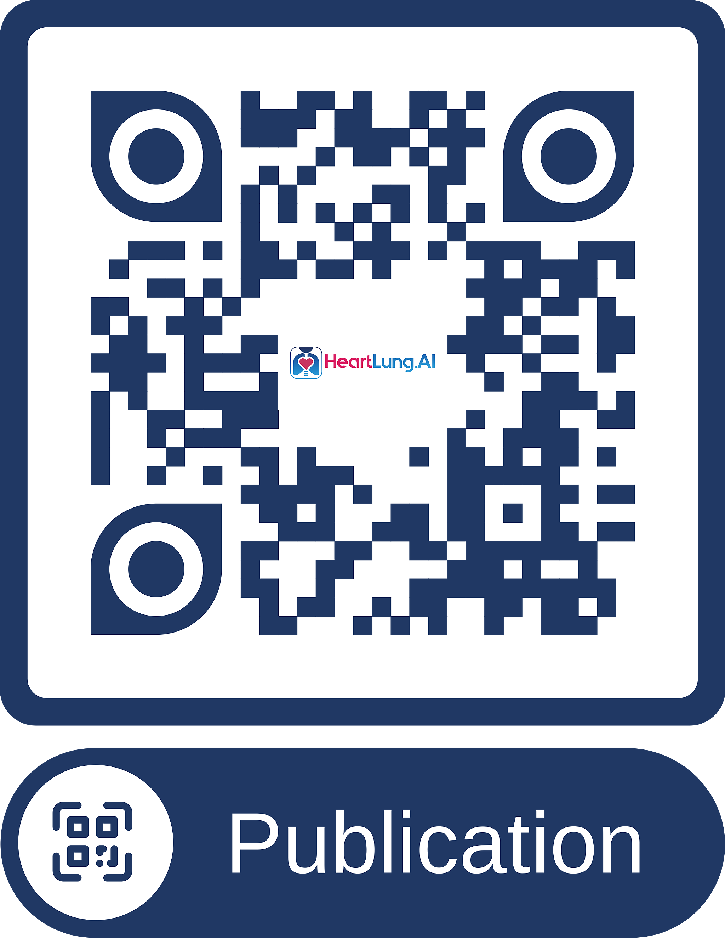
AI-CVD Imaging Biomarkers
Naghavi, M., et al. (2023). "Opportunistic AI-enabled automated bone mineral density measurements in lung cancer screening and coronary calcium scoring CT scans are equivalent." European Journal of Radiology Open 10: 100492.
Notes:
AI-CVD is a platform designed to extract multiple cardiometabolic and systemic biomarkers from coronary artery calcium scans to improve cardiovascular disease prediction and prevention. These biomarkers include coronary artery calcification, extracoronary calcifications such as valvular and aortic calcification, cardiac chamber volumes and ratios, great vessel measurements, epicardial and visceral adiposity, liver fat, muscle volume and myosteatosis, bone mineral density, as well as lung abnormalities such as emphysema and fibrotic changes.

Slide 9
What Is the Value of AI-CVD?
Imaging Biomarkers May Provide Improved Cardiovascular Disease Prediction Beyond Conventional Risk Factors
Notes:
What Is the Value of AI-CVD? The concept behind AI-CVD is that imaging biomarkers may improve cardiovascular disease prediction beyond conventional risk factors. This concept is based on evidence from previous studies showing that coronary calcification may be a stronger predictor of coronary heart disease than dyslipidemia; cardiac chamber size may be more important than blood pressure for predicting heart failure; and liver adiposity may predict diabetes even in non-obese individuals with normal blood glucose levels.

Slide 10
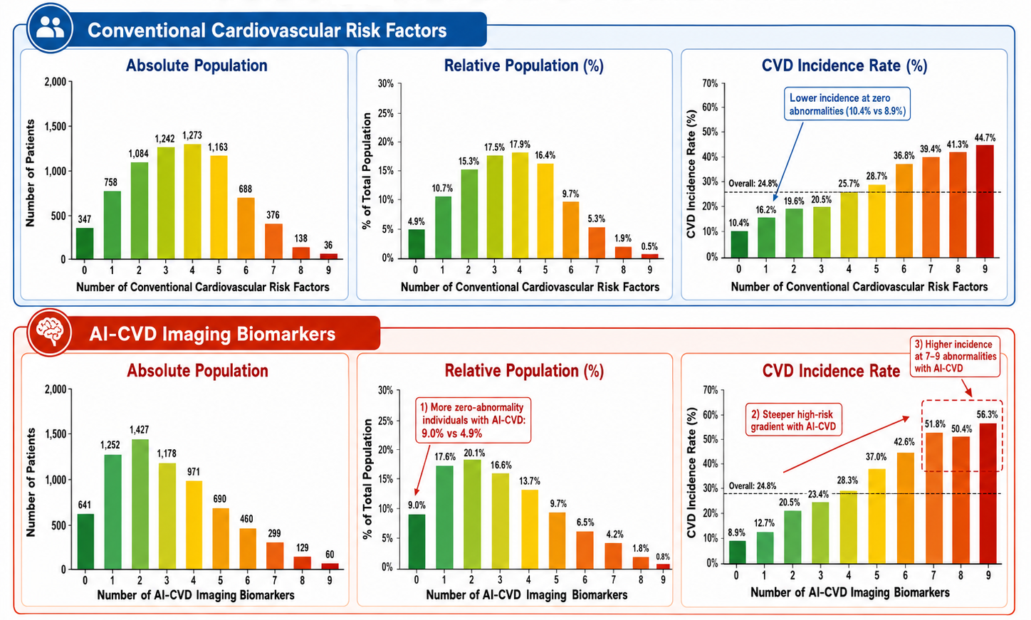
AI-CVD vs CVD risk factors
Pooled MESA and FHS Study
Notes:
In a pooled cohort of MESA and FHS with around 7000 asymptomatic population we compared the number of abnormal conventional risk factors with the number of abnormal imaging biomarkers

Slide 11
AI-CVD vs CVD risk factors
Pooled MESA and FHS Study
Notes:
And we observed a lower incidence of cardiovascular disease among individuals with fewer abnormal imaging biomarkers and a higher incidence among those with a greater burden of imaging abnormalities compared with conventional risk factors

Slide 12
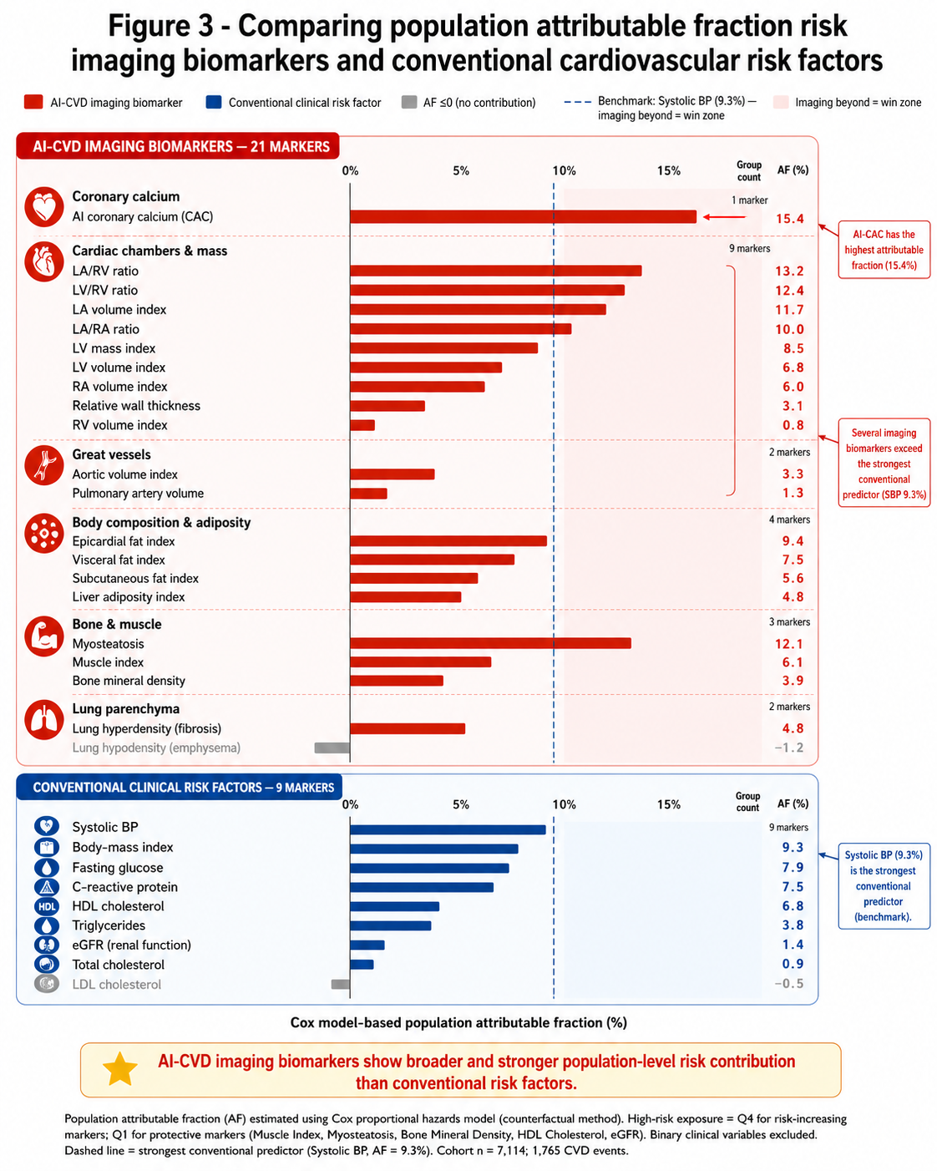
What Is the Value of AI-CVD?
Pooled Cohort of MESA and FHS
Notes:
in the same population

Slide 13
What Is the Value of AI-CVD?
Pooled Cohort of MESA and FHS
Notes:
in the same population conventional risk factors showed population attributable fractions ranging from 1% to 9%, with systolic blood pressure having the highest contribution at 9.3%.

Slide 14
What Is the Value of AI-CVD?
Pooled Cohort of MESA and FHS
Notes:
However, the population attributable fraction increased to 15% for AI-CVD imaging biomarkers. AI-derived coronary artery calcium scores, cardiac chamber measurements and ratios, and adiposity measures showed higher attributable fractions compared with blood pressure and other risk factors for all cardiovascular disease.

Slide 15
How Can We Use These AI-CVD Biomarkers in Clinical Practice?
By applying outcome-specific AI-CVD models designed to predict individual cardiovascular conditions
Notes:
Based on these findings, you may ask: how can we use these abnormal imaging biomarkers in clinical practice? The answer is

Slide 16
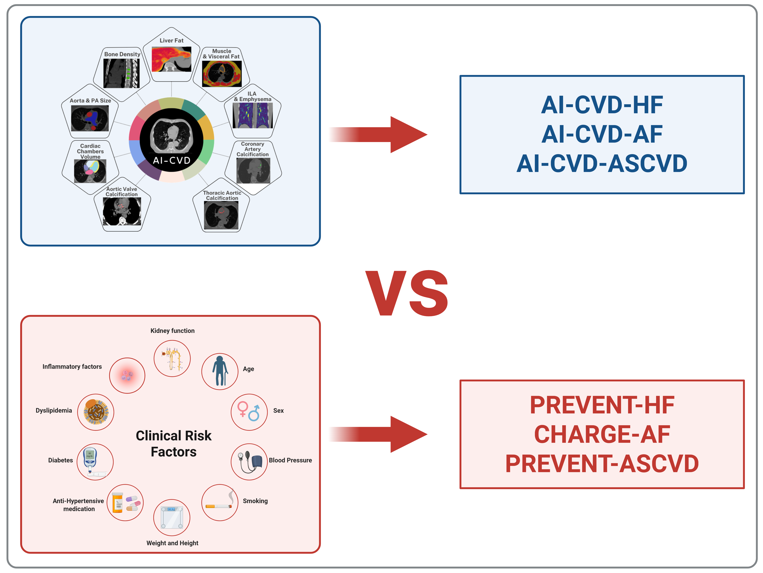
AI-CVD vs CVD Risk Factors
Notes:
Current guidelines recommend several outcome-specific risk models based on conventional cardiovascular risk factors, including PREVENT-HF for heart failure, CHARGE-AF for atrial fibrillation, and PREVENT-ASCVD for atherosclerotic cardiovascular disease. These models use variables like dyslipidemia, blood pressure, obesity, and smoking. We developed corresponding AI-CVD models that use only AI-derived imaging biomarkers to predict these outcomes.

Slide 17
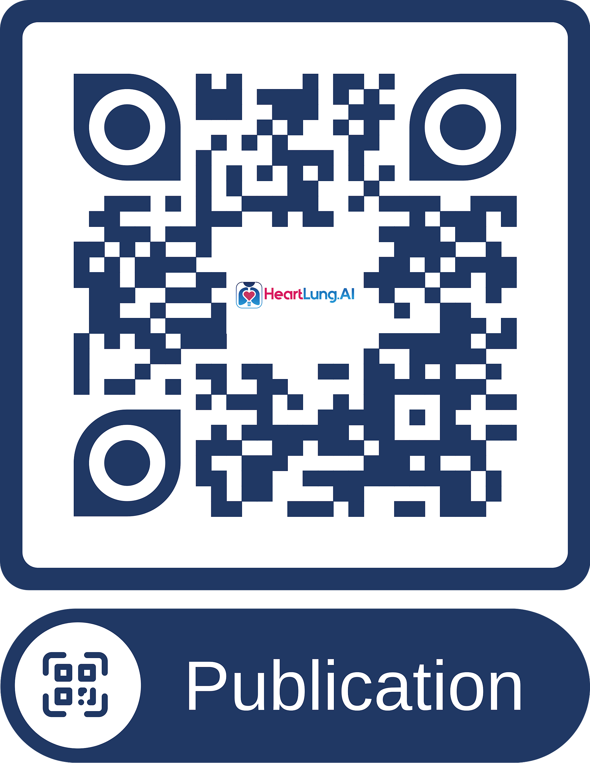
AI-CVD-HF vs PREVENT-HF
Pooled Cohort of MESA and FHS
Notes:
First, we developed AI-CVD-HF, a model for predicting heart failure that incorporates multiple AI-derived imaging biomarkers.

Slide 18
AI-CVD-HF vs PREVENT-HF
Pooled Cohort of MESA and FHS
Notes:
This model significantly improved heart failure prediction compared with PREVENT-HF, the currently recommended risk score based on conventional cardiovascular risk factors for heart failure prediction.

Slide 19
AI-CVD-AF vs CHARGE-AF
Pooled Cohort of MESA and FHS
Notes:
For atrial fibrillation, we developed AI-CVD-AF (mention the component of clinical risk factors)

Slide 20
AI-CVD-AF vs CHARGE-AF
Pooled Cohort of MESA and FHS
Notes:
Which demonstrated comparable predictive performance to CHARGE-AF clinical risk score.

Slide 21
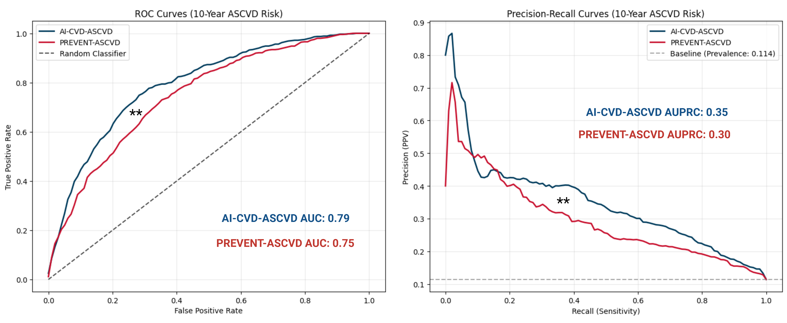
AI-CVD-ASCVD vs PREVENT-ASCVD
Pooled Cohort of MESA and FHS
Notes:
Finally, we developed AI-CVD-ASCVD, a model for predicting atherosclerotic cardiovascular disease which significantly improved this disease prediction compared with PREVENT-ASCVD, the risk score recommended by the American Heart Association.

Slide 22
Take Home Message

Slide 23
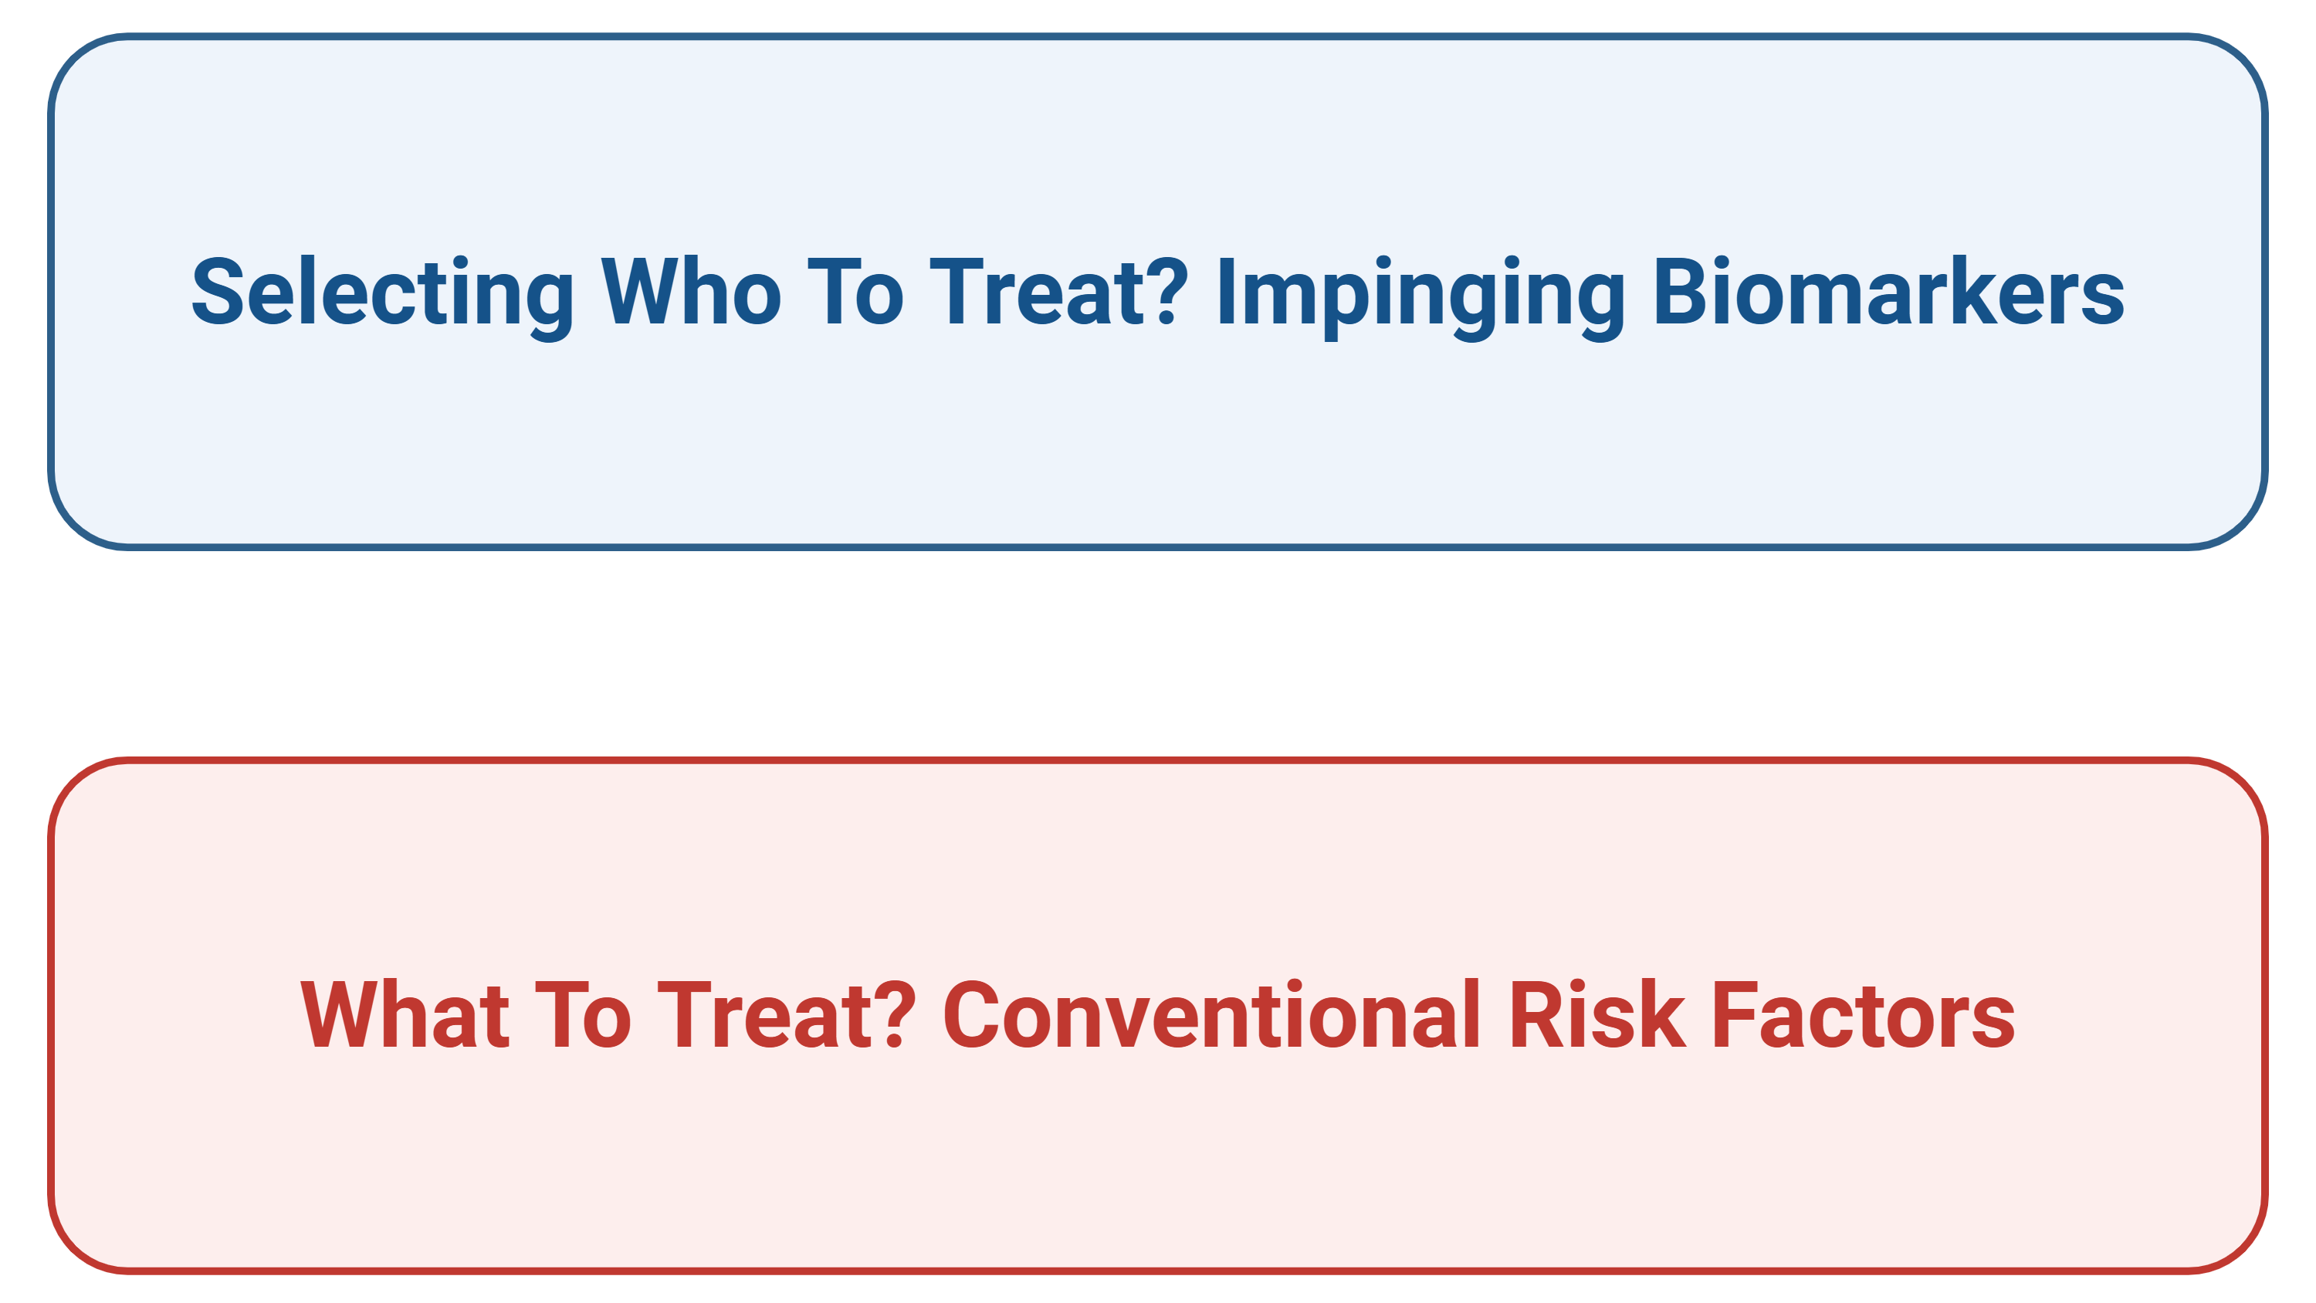
Take Home Message
Notes:
Our results suggest that imaging biomarkers can provide better cardiovascular disease prediction compared with conventional cardiovascular risk factors and may help identify patients who would benefit most from targeted treatment and improved control of modifiable risk factors.

Slide 24
Thank you for your attention reza.mirajlili@heartlung.ai

